Slide 1
Product Knowledge Training Session PIBAS Products -
COLLATERAL MANAGEMENT
Presented By PIBAS Support Team

Slide 2
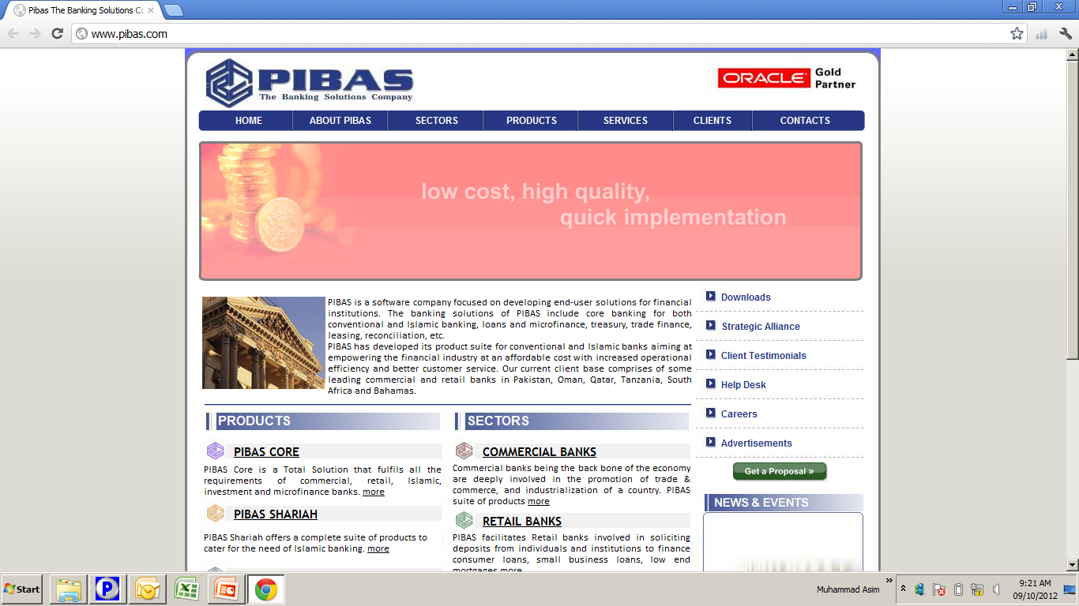
What is Collateral? (Definition)
Collateral Management
Category Management
Collateral Re-Evaluation
Category Re-Evaluation
Collateral Reports
Category Reports
Contents
Collateral Management

Slide 3
Collateral Management
What is Collateral? (Definition)
Collateral means security / guarantee that is required by lending institutions (banks or any other financial institution) from the borrower before sanctioning any loan facility. Through these collaterals, these institutions mitigate and cover their risk of lending (s). In case of any non-payment of borrower, these collaterals may be encashed as per the procedures / rules defined by these institutions. Our PIBAS Plus system very smartly records these collateral in a systematic manner that will be thoroughly discussed / learned through this training.

Slide 4
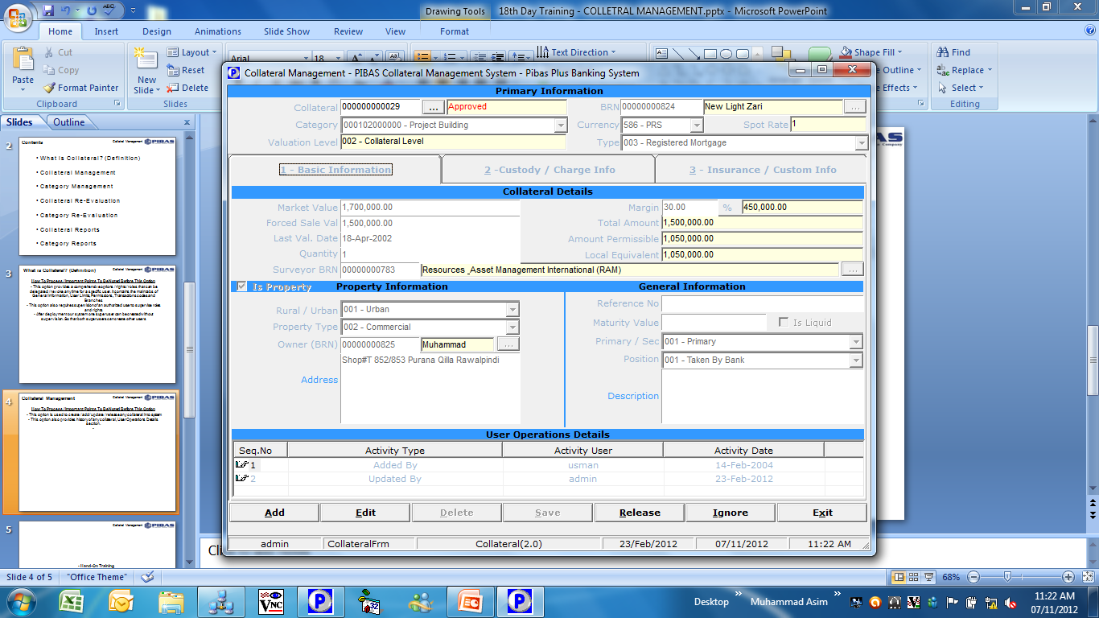
Collateral Management
Collateral Management
How To Process / Important Points To Be Noted Before This Option
This option is used to create / add / update / release any collateral into system
This option also provides history of any collateral, User Operations Details section.

Slide 5
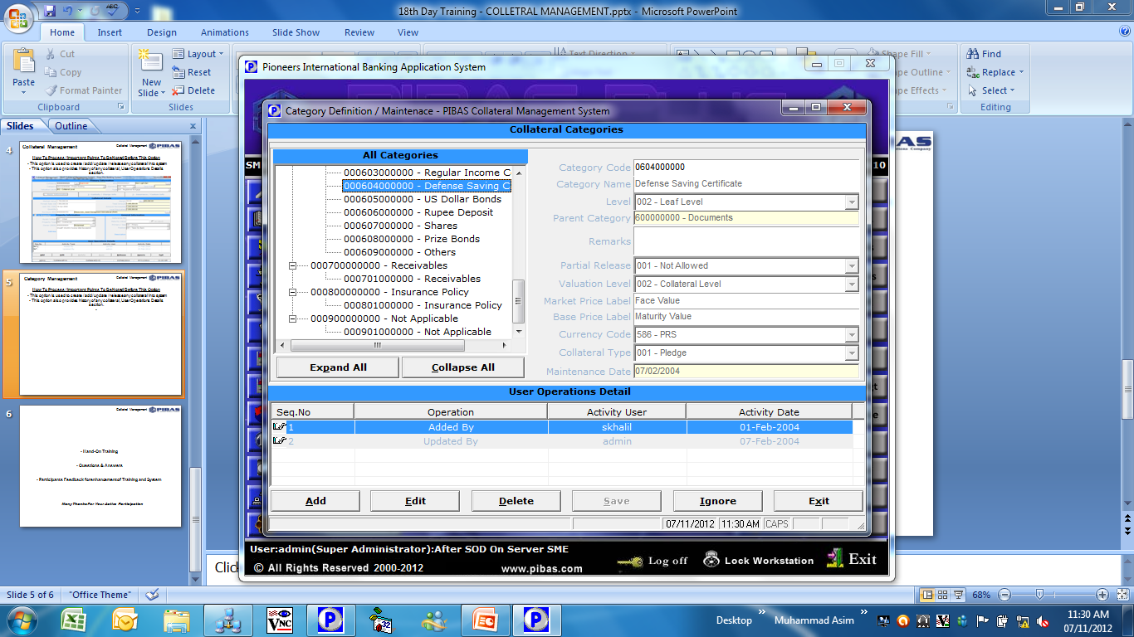
Collateral Management
Category Management
How To Process / Important Points To Be Noted Before This Option
This parameter option is used to create / change / delete any category of a collateral.
According to these parameters system behaves while manipulating any collateral records in system.

Slide 6
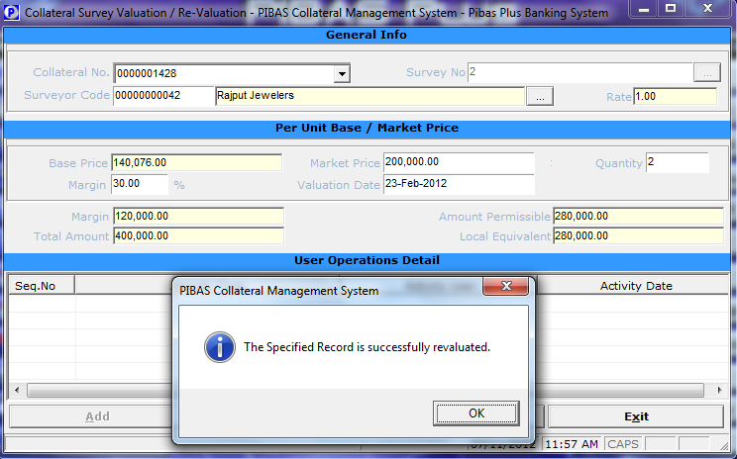
Collateral Management
Collateral Re-Evaluation
How To Process / Important Points To Be Noted Before This Option
This option is used upon receipt of surveys from approved panel surveyors from time to time and system will update the correct information of an individual Collateral.

Slide 7
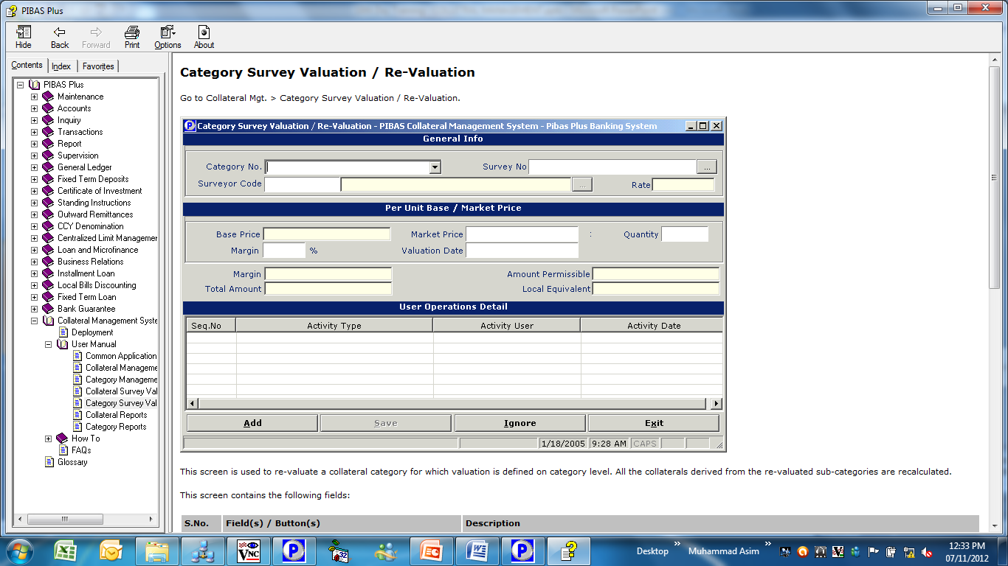
Collateral Management
Category Re-Evaluation
How To Process / Important Points To Be Noted Before This Option
This option is used upon receipt of surveys from approved panel surveyors from time to time and system will update the correct information of a specific Category. In other words, this option updates all the collaterals under a specific category.

Slide 8
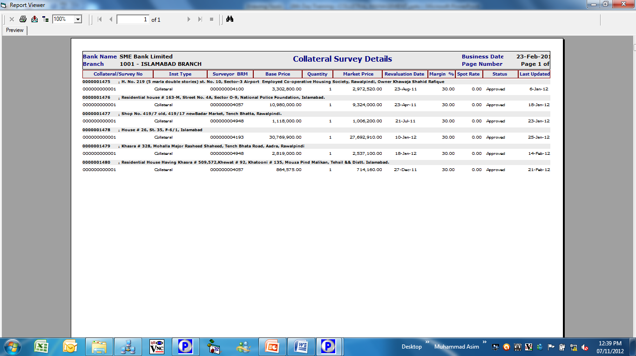
Collateral Management
Collateral Reports
How To Process / Important Points To Be Noted Before This Option
Through this option, different reports can be produced through pre-designed formats and through user customized inputs as well.

Slide 9
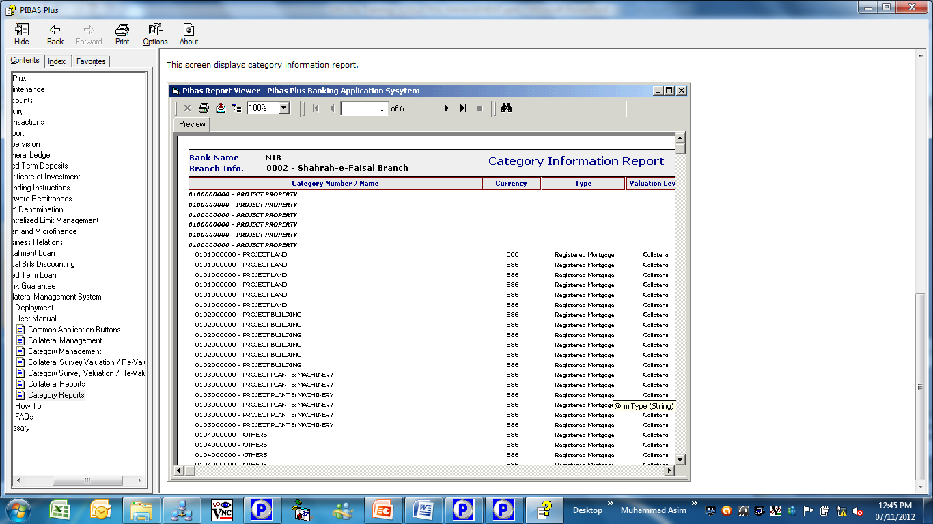
Collateral Management
Category Reports
How To Process / Important Points To Be Noted Before This Option
Through this option, following report could be generated

Slide 10
Collateral Management
Hand-On Training
Questions & Answers
Participants Feedback for enhancement of Training and System
Many Thanks For Your Active Participation

